Slide 1
Molecular Dynamics and Time Stepping
Yuan Ping

Slide 2
Outline
R. Lesar, Introduction to Computational Materials Science, ch. 6
Taylor expansion
Verlet algorithms
Choosing the time step

Slide 3
The Basic MD Problem Time Step
Start with positions and velocities at time t_{k}: r(t_{k}),v(t_{k})
Find the forces on each particle at t_{k}: F(t_{k})
Find the accelerations of each particle at t_{k}: a(t_{k})
Use r(t_{k}), v(t_{k}), a(t_{k}) to get the correct positions and velocities at t_{k+1} = t_{k} + δt : r(t_{k+1}), v(t_{k+1})
Iterate this process to evolve the system in time
*** How do I do step 4? ***
Use a Taylor expansion!!

Slide 4
Taylor Expansions For Time Steps
Use “p” denoting our predicted values.
r^{p}(t+δt) = r(t) + v(t)δt + 1/2a(t)δt² + O(δt³)
v^{p}(t+δt) = dr/dt = v(t) + a(t)δt + O(δt²)
a^{p}(t+δt) = d²r/dt² = F(r^{p}(t+δt))/m
If you know r,v,a at t, you can predict r, v at t+δt from these equations, then get a(t+δt) from forces and repeat.
At each new step you update the accelerations
Dashed: exact
Solid: simple equ. above
one-dimensional harmonic oscillator

Slide 5
Verlet Algorithm
Assume we have r(t), v(t), a(t), consider both forward and backward time step, and sum them (this averages around r(t) and gives r(t+δt) accurate to O(δt⁴)).
Forward time step: r(t+δt) = r(t) + v(t)δt + 1/2a(t)δt²
Backward time step: r(t-δt) = r(t) - v(t)δt + 1/2a(t)δt²
Verlet Algorithm: r(t+δt) = 2r(t) - r(t-δt) + a(t)δt²
Time reversible (properly centered), accurate trajectories, good energy conservation even for long time step, quite fast + simple
But how do we get v(t+δt)? Subtract above two Eqs to get
v(t+δt) = [r(t+δt) - r(t-δt)]/ 2δt (v(t+δt) only accurate to O(δt²))
Note that local error (1 time step) is O(δt⁴) for r, O(δt²) for v.
The use of backward time is awkward (algorithm is not “self-starting”) so we can fix it in the Velocity Verlet algorithm

Slide 6
Velocity Verlet Algorithm
r(t+δt) = r(t) + v(t)δt + 1/2a(t)δt²
v(t+δt) = v(t) + 1/2[a(t)+a(t+δt)]δt
How does this compare to regular Verlet?
Equivalent to Verlet in accuracy
“self-starting” (ie, don’t need data from t₀-δt when you start at t₀)
Don’t need to store data from 2 time steps so uses less memory than Verlet.
This is a commonly used algorithm
Fast, simple, accurate trajectories, energy conservation for long time steps – a very good method!

Slide 7
Main Source of Error in MD: The Time Step
We are integrating the equations of motion numerically
We have discretized the continuous process into time steps of size δt
Discretization will introduce errors at every time step that are larger for larger δt
But simulations take longer for smaller δt (more calculations for the same amount of time)
Choosing optimal δt is a trade-off between accuracy and simulation time
Key ways you see time step error in NVE MD are energy fluctuations and drift.

Slide 8
Choosing the Time Step δt
No MD follows the true trajectories for very many time steps – errors always accumulate. The time over which the MD trajectory ≈ true trajectory is called correlation time.
No MD truly conserves energy since there are always errors. The goal is to have a nearly constant average E (no drift) with fluctuations as small as possible.
In practice, drift should be unmeasurably small during your simulation, and fluctuations <10⁻⁴ x total E (if we assume this is total formation E from atoms this is < ≈1 meV/atom)
Key properties should be independent of time step

Slide 9
Choosing the Time Step δt
δt should be as large as possible to still get accurate trajectories (on the time scale needed) and conserve energy
In general, δt should be ≈0.01 x the fastest behavior of your system (E.g., atoms oscillate about once every 10⁻¹³ s in a solid ⇒ MD time steps are ≈ 10⁻¹⁵ s = 1fs in simulations of solids. In practice 1-3 fs is a good range to use.

Slide 10
Time Step and Energy Conservation Drift Error
If Newton’s equation are exactly integrated, the total energy is constant.
With discretization, the total energy is not rigorously conserved anymore and will tend to increase.
Conservation of energy is a good measure for how small dt we should use
Energy can fail to be conserved in two ways
Drift: The average energy drifts from true value during simulation.
Fluctuation: The energy jumps around a lot on short time scales, but the overall average is good.
Energy
δt~10⁻¹⁴
δt~10⁻¹⁵
Exact
How much drift is acceptable? One rule could be error < 1 meV/atom over time of simulation, as 1 meV/atom is likely a negligible error. So for 100ns this requires drift < 0.01 meV/(atom-ns).
Time

Slide 11
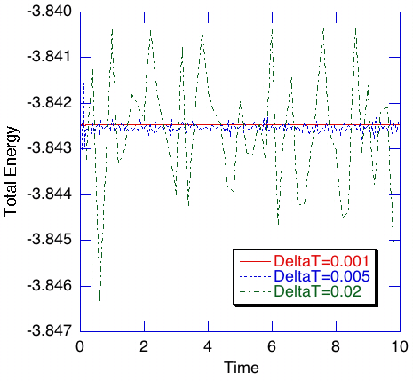
Time Step and Energy Conservation Fluctuation Error
Szlufarska, private communication (from Nakano)
Time steps are Lennard-Jones units
Notes:
Delta T is in normalized units is typically used for the Lennard-Jones potential

Slide 12
Summary
Key issue is how to step the time in the MD to get
Correct trajectories if needed (not usually important in atomistic modeling)
Low enough fluctuations and low enough drift in energy to obtain good thermodynamic averages
Must choose time step small enough for accuracy but not so small simulations is unnecessarily slow.
Time step algorithm: Verlet, Velocity Verlet, based on Taylor expansion approach.

Slide 13
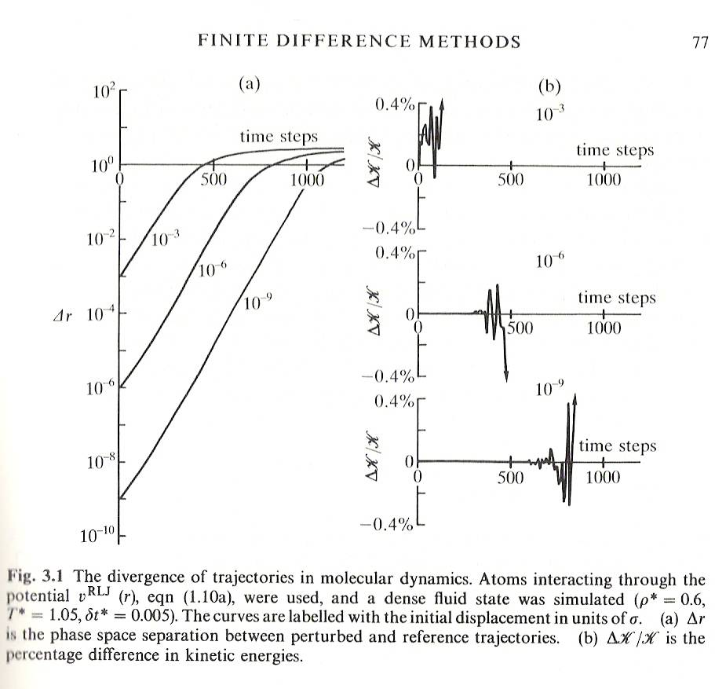
Time Step and Path Divergence
Allen and Tildesley, Computer Simulation of Liquids, 1989

